Slide 1
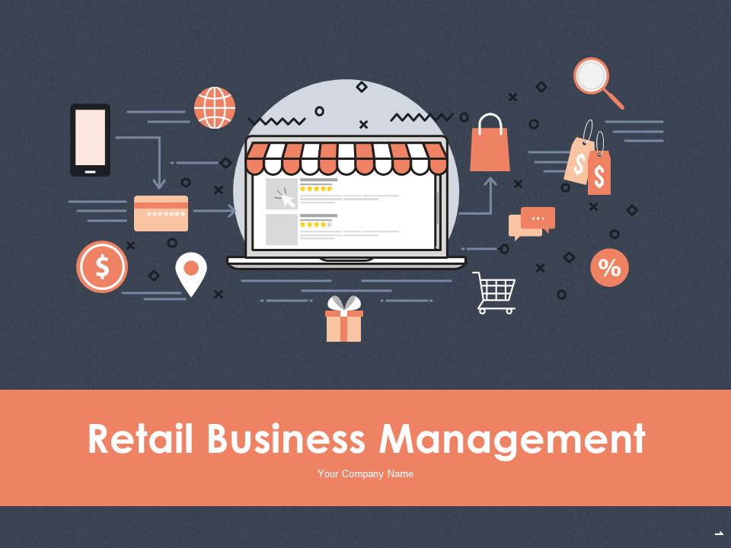
Retail Business Analysis Report
using Python
Created By: Keerthi Das
Created On: May 2022

Slide 2
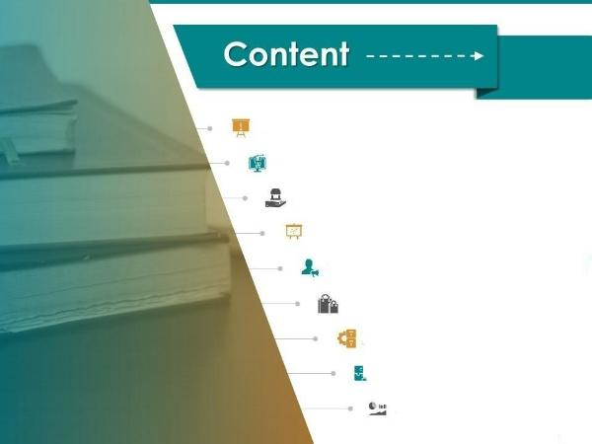
Introduction
Agenda
Key Performance Indicators
Statistical summary and trends
Category, Location-Wise Performance
Basic insights on categorical data
Key findings & Recommendations
Data cleaning steps taken
Conclusion

Slide 3
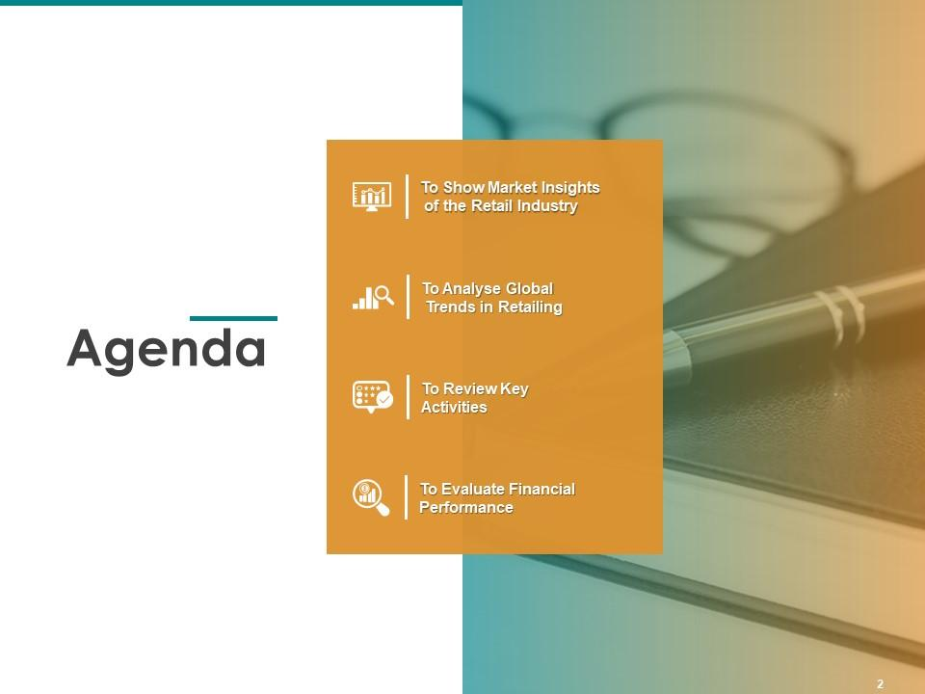
To show market insights of our retail business
To analyse trends of our business in industry
To review key activities in the business
To evaluate financial performance in the market

Slide 4
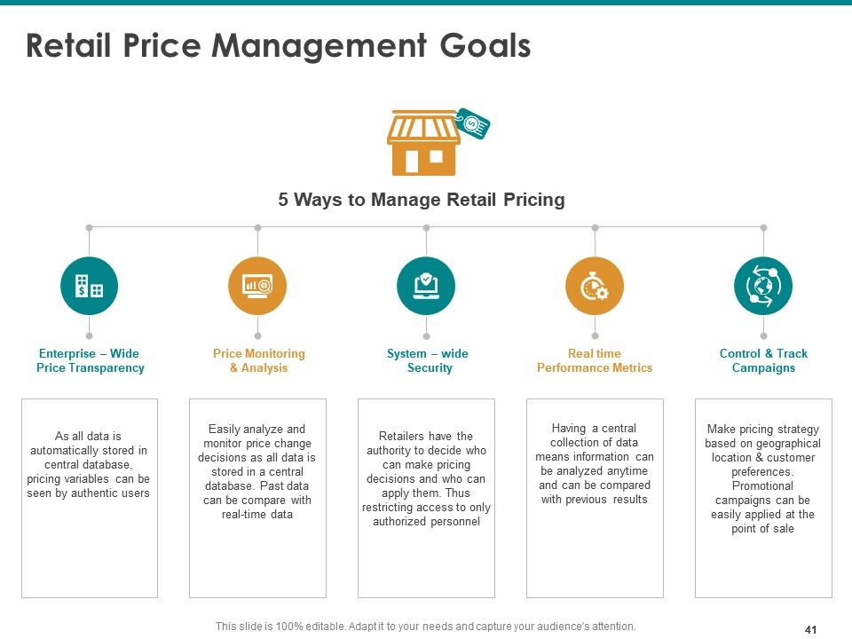
Key Performance Indicators
Key Statistics
Revenue
Age: 30-52
Location
Category
Trend
Highest revenue is generated from e-shopping, accounting to nearly 2.3 crores
Min age is 30 and max is 52. 75% customers lie in 47 years age bracket
Highest total transaction amount came from India amounting 5.7 million
Most sold category is ‘Books’ & least being ‘Bags’ with only 5349 orders of all time
The period after Financial Year 2014 faced a downfall in transactions

Slide 5
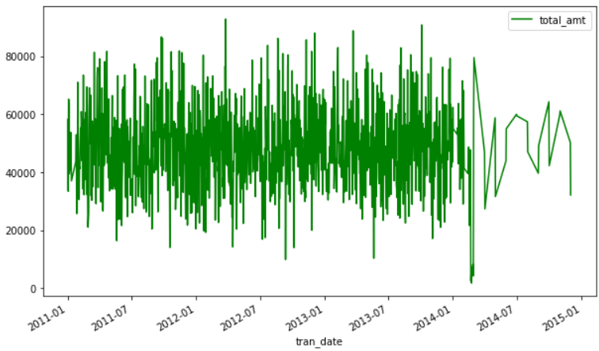


Timeline and Trend of transactions made
Key findings:
Timeline: Jan 2011 to Jan 2015
Trend: The frequency of the wave has reduced after Jan 2014.Which means the no.of transaction decreased

Slide 6
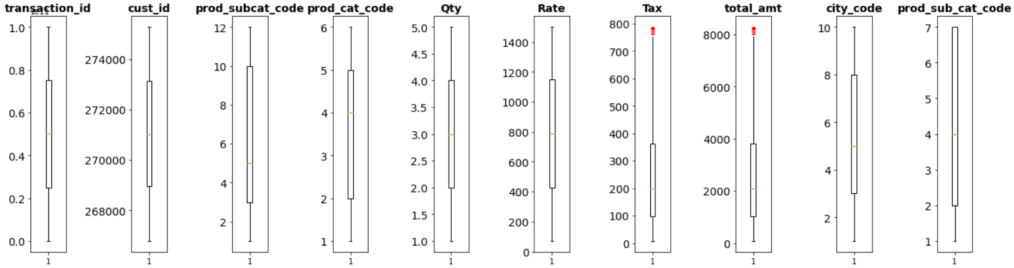
Statistical Summary

Slide 7
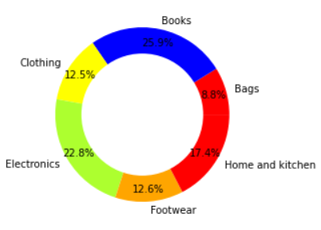
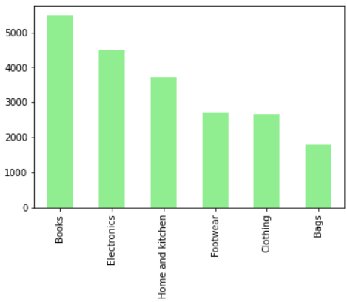
Basic insights on different Product Categories
No.of orders by Product Category
The above donut chart gives insights of Total revenue from "Electronics" & "Clothing" categories from Flagship Stores

Slide 8
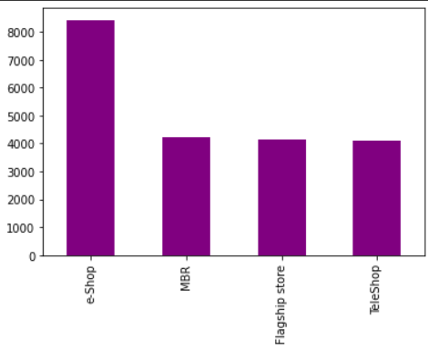
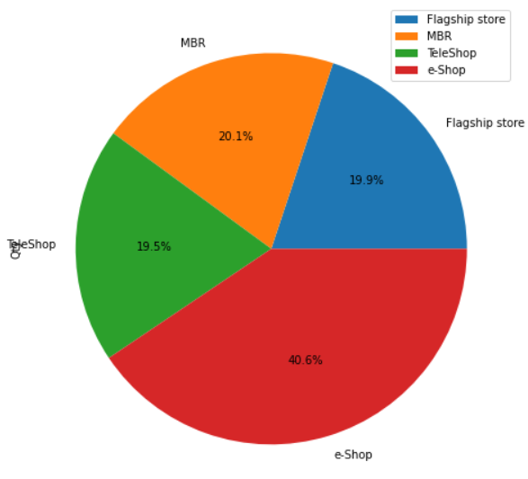
No.of transactions by Store type
Basic insights on Store-types
No.of orders for each store type
Total quantity sold by Stores
Key findings:
Most orders were placed via e-shopping which explains the high quantity sold via this store.

Slide 9
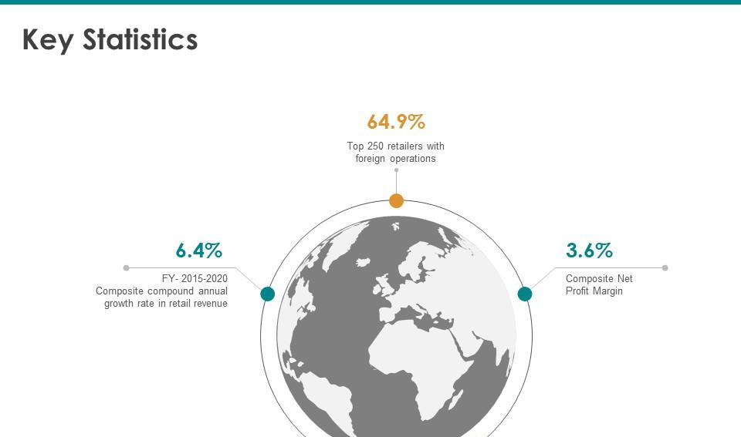



Location-wise insights:
India
Top region in terms of revenue, no.of stores and customer base
Australia
Region with least customer base and least quantity ordered
China
Top 2nd location in terms of revenue but Top 1 in total quantity

Slide 10
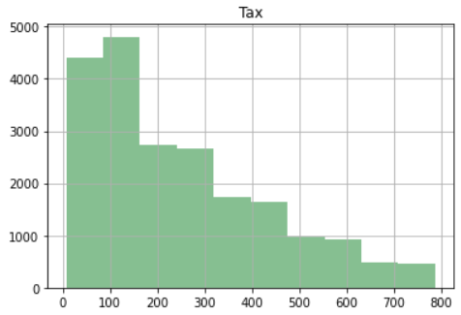
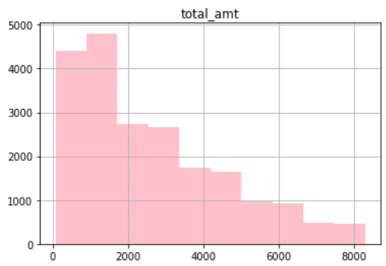
Both histograms looking similar?
Let’s check their relation in the next slide.

Slide 11
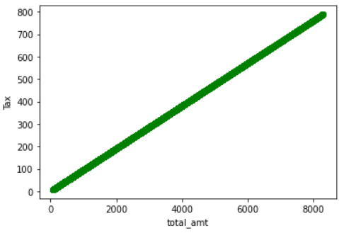
Correlation between Tax and Total order amount
You’ve guessed it correct!
Tax and Total amount are correlated.
Tax will be levied based on the total amount.
The more is the amount, so will be the tax!

Slide 12
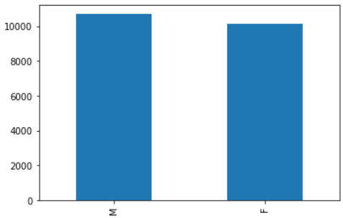
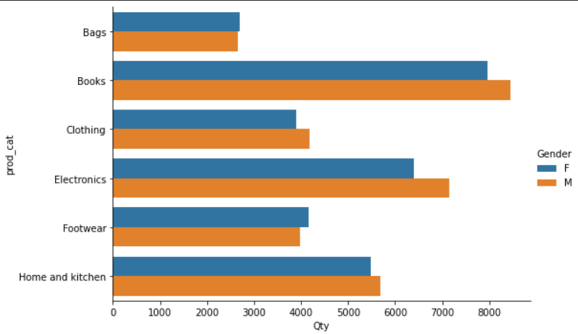
Gender-wise insights
No.of transactions by Gender
Male Vs. Female purchases by Product category
Insights:
No.of orders by Male & Female customers are almost same.
Books is the popular category among both customer segments.
.

Slide 13
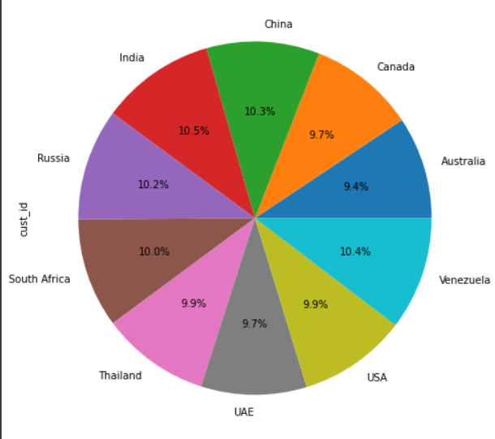
Percentage of customer base by region
Insights:
Customers are almost evenly distributed among all cities.
There is no big difference between no.of customers in Gender-wise segmentation too(as per previous slide).
Bravo! This could mean that we are inclusive irrespective of Gender or Region.
.

Slide 14
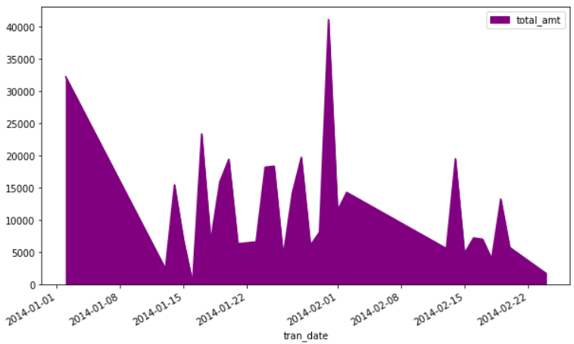
For all customers aged between 25 - 35 :
A. What was the total amount spent for “Electronics” and “Books” product categories?
B. Total amount spent by these customers between 1st Jan, 2014 to 1st Mar,2014
5572389.03
Total amount spent
6407.0
Total Quantity Ordered
8281.975
Max of order amount

Slide 15

Recommendations
To show market insights of a retail business
75% of customers fall in 47 years age bracket & min, max ages are 30, 52. This means most customer base lie in 30-47 years. We need to attract all other age brackets.
Bags, Clothing, Footwear were the least sold categories. We need to focus more on sales for these categories in the up-coming quarter
The period after Financial Year 2014, faced a downfall with very few transactions. This could mean the customers are churning or could simply mean data is missing.
Australia had the least customer base & least order quantity. We need to take steps to improve the customer base that could potentially take the company’s revenue to next level

Slide 16
Key changes made to dataset-PreProcessing
Changed data types appropriately
Renamed columns appropriately
Merged 3 multiple tables to perform analysis
Dropped nulls,duplicates that could potentially skew results
Replaced “-”, “,” etc to ensure data is in consistent format

Slide 17
Good luck!
I hope you’ll use these insights to go out and deliver a memorable pitch for your product or service!
To access the python notebook used for this analysis, please click here:
https://colab.research.google.com/drive/1X5ZWgfcg7KsgzwtVo-zrC60U3HE1slu0?usp=sharing

